Slide 1

TRAIN RESERVATION SYSTEM
Parthiban Palanivel
ADM JAVA - ANGULAR

Slide 2
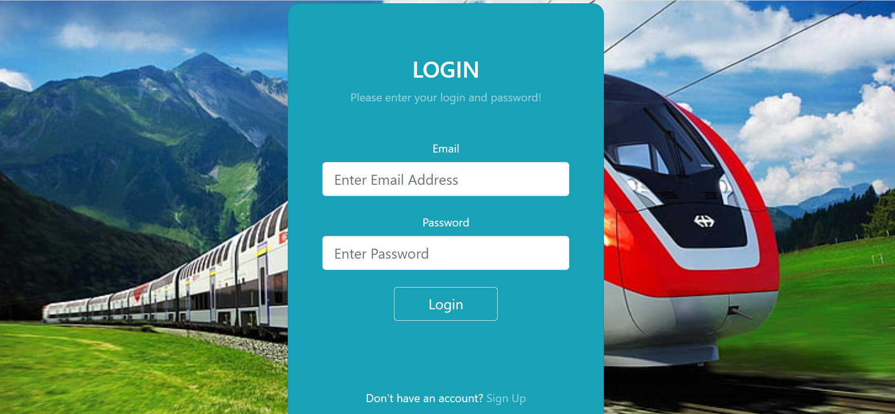
Login Page

Slide 3
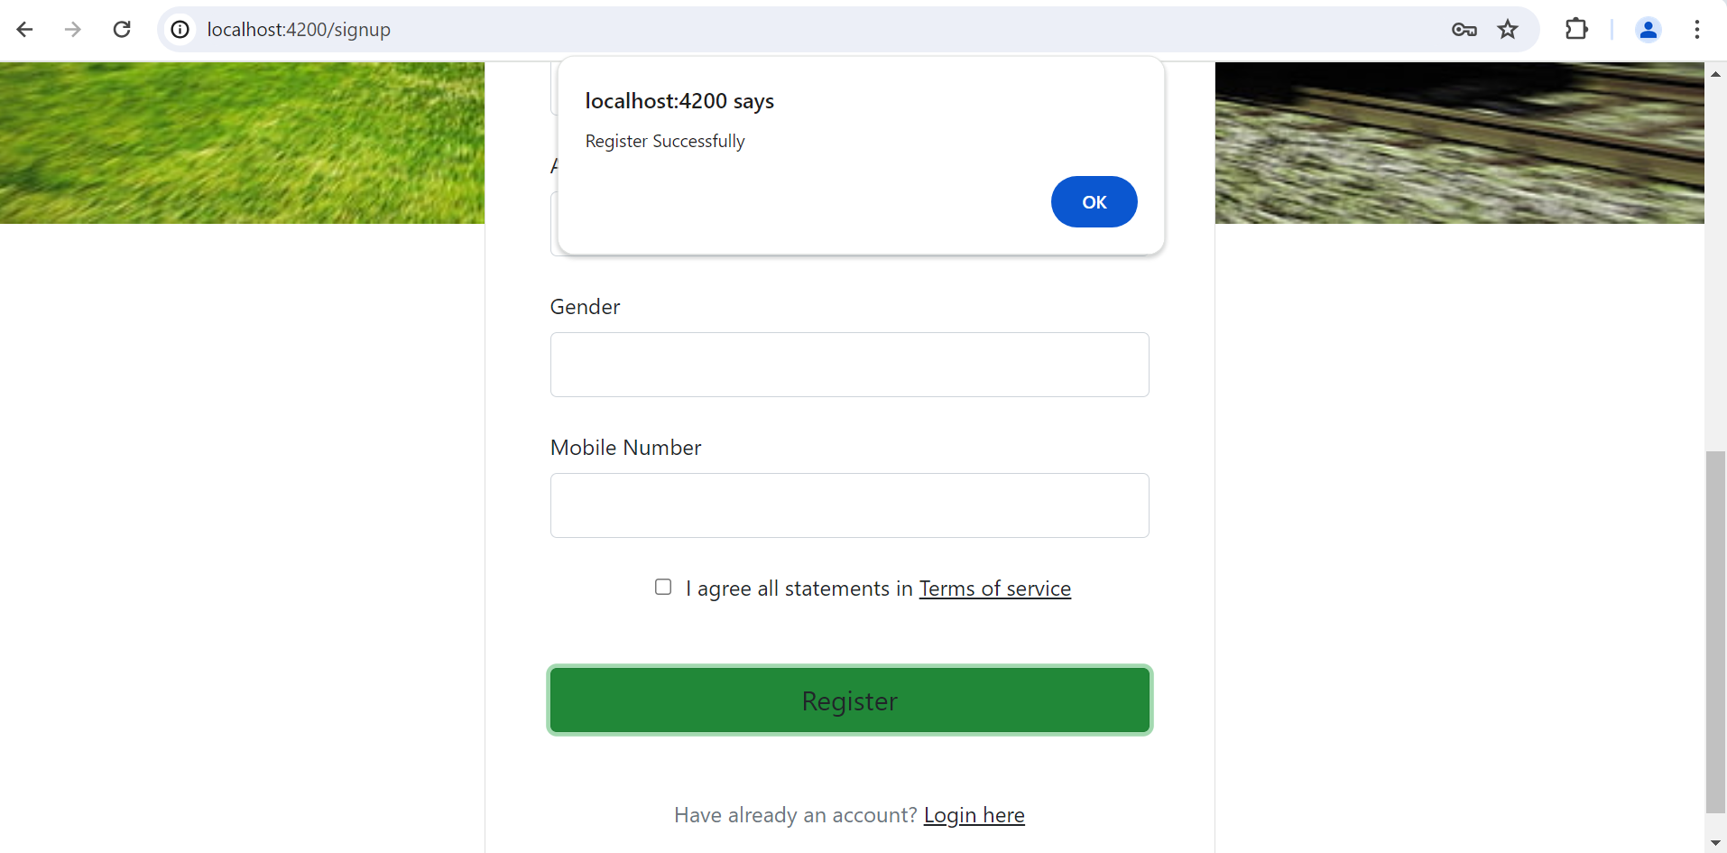
Registration Page

Slide 4
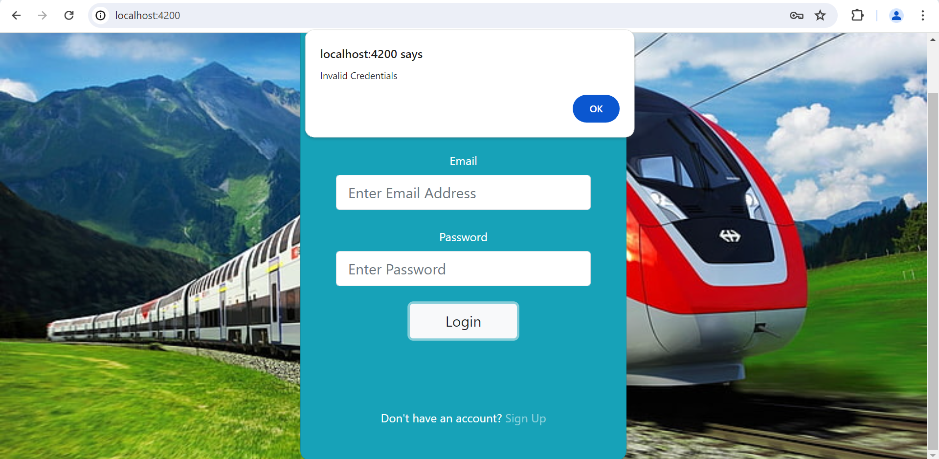
Invalid Credentials

Slide 5
ADMIN PAGE

Slide 6
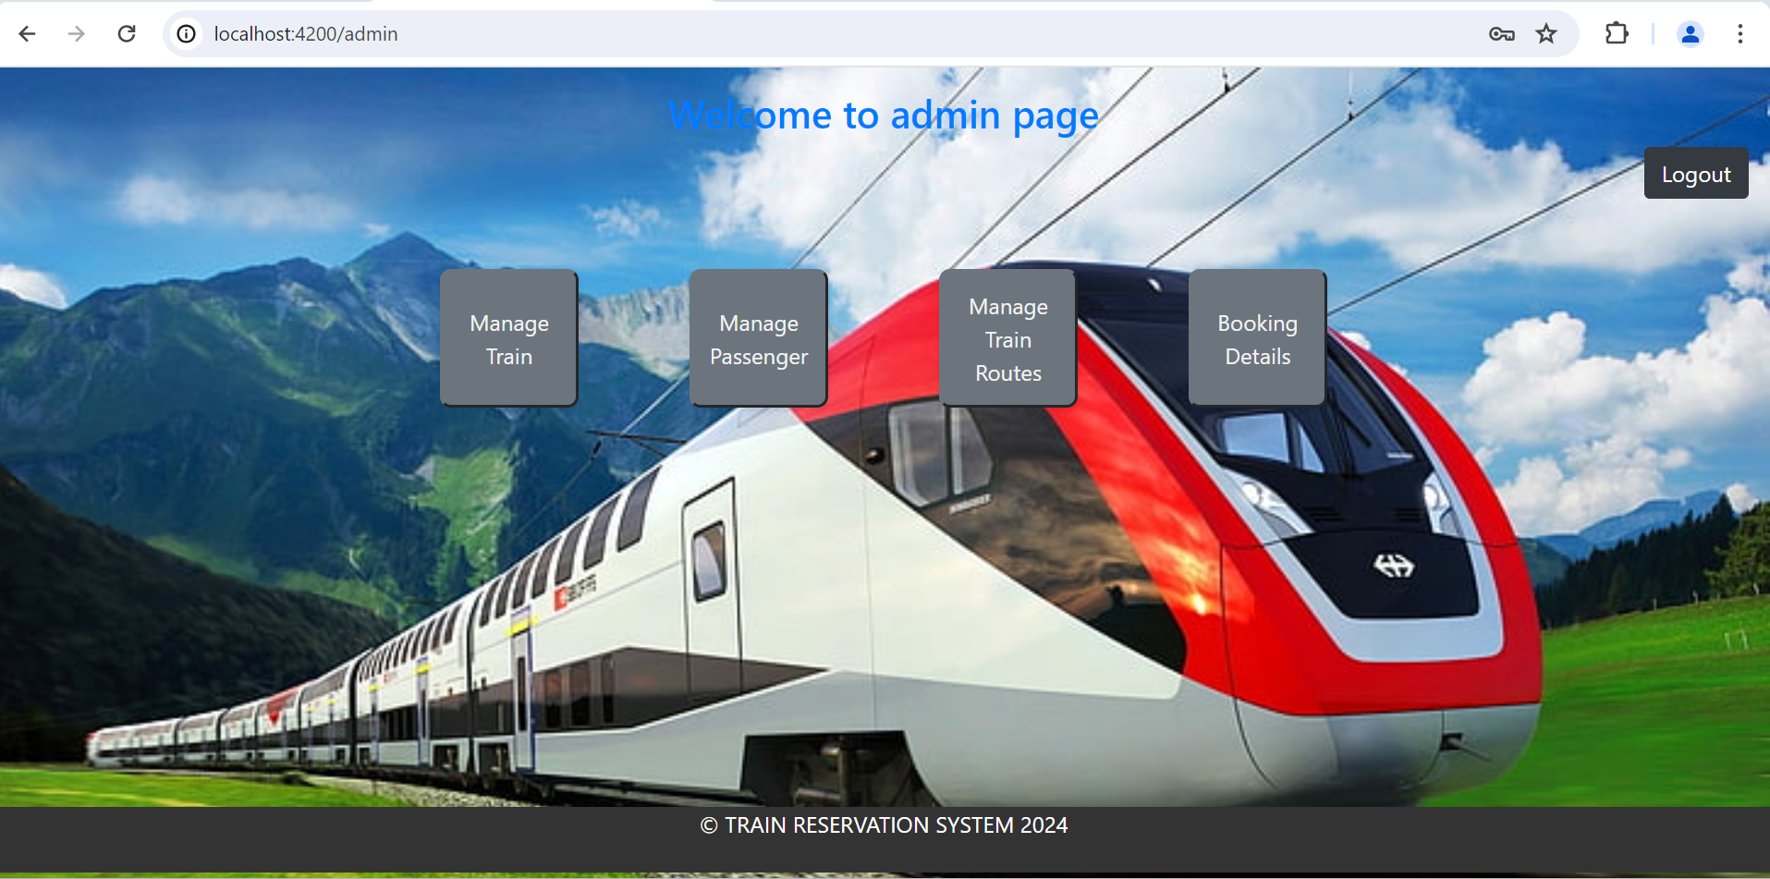
Admin Home Page

Slide 7
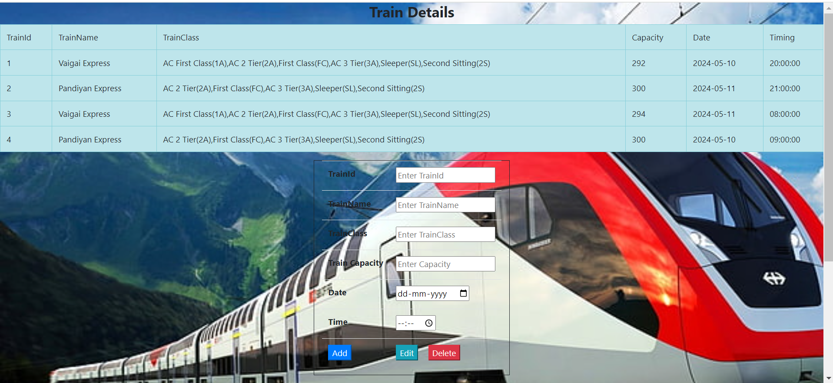
Manage Train Details

Slide 8
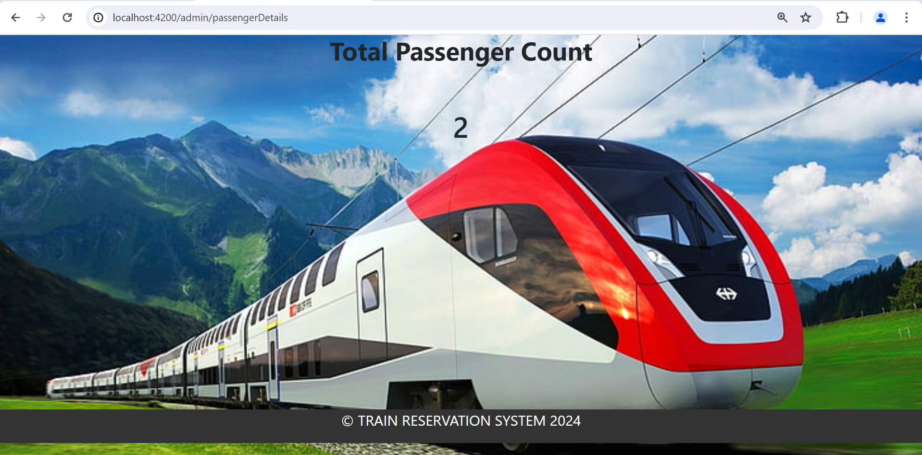
Passenger Registration Count

Slide 9
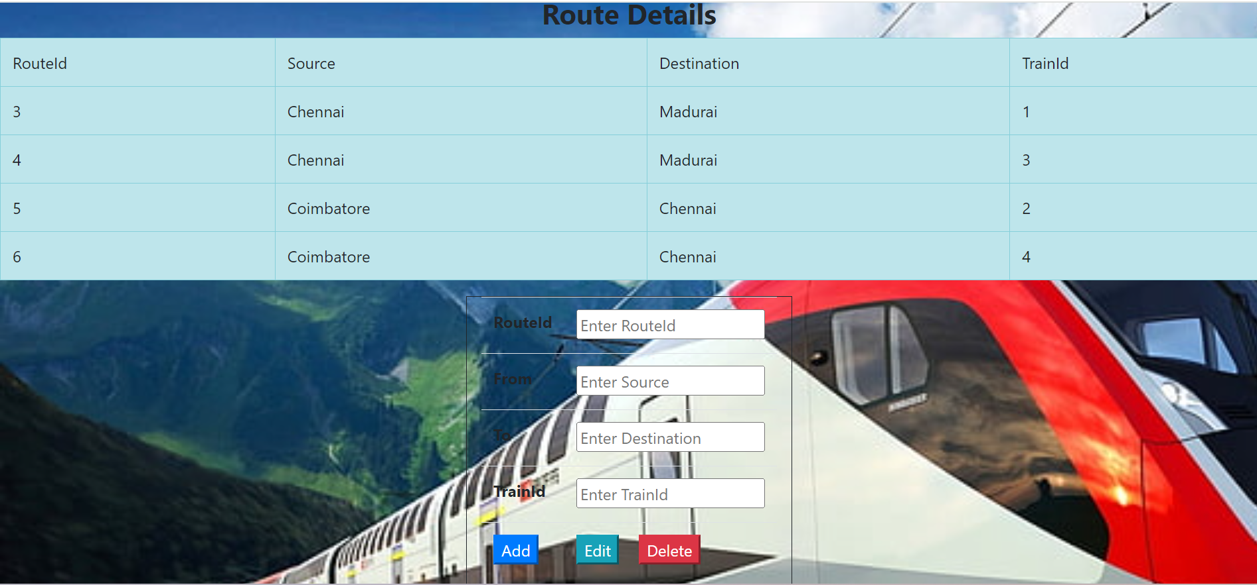
Manage Train Route Details

Slide 10
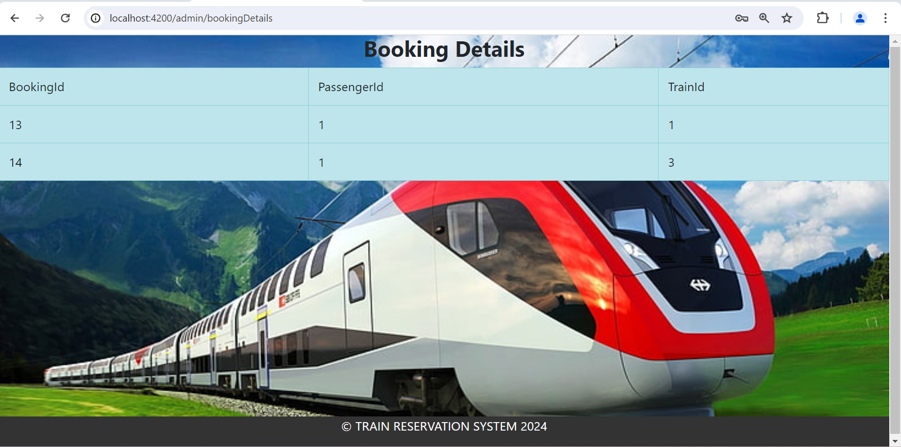
Booking Details

Slide 11
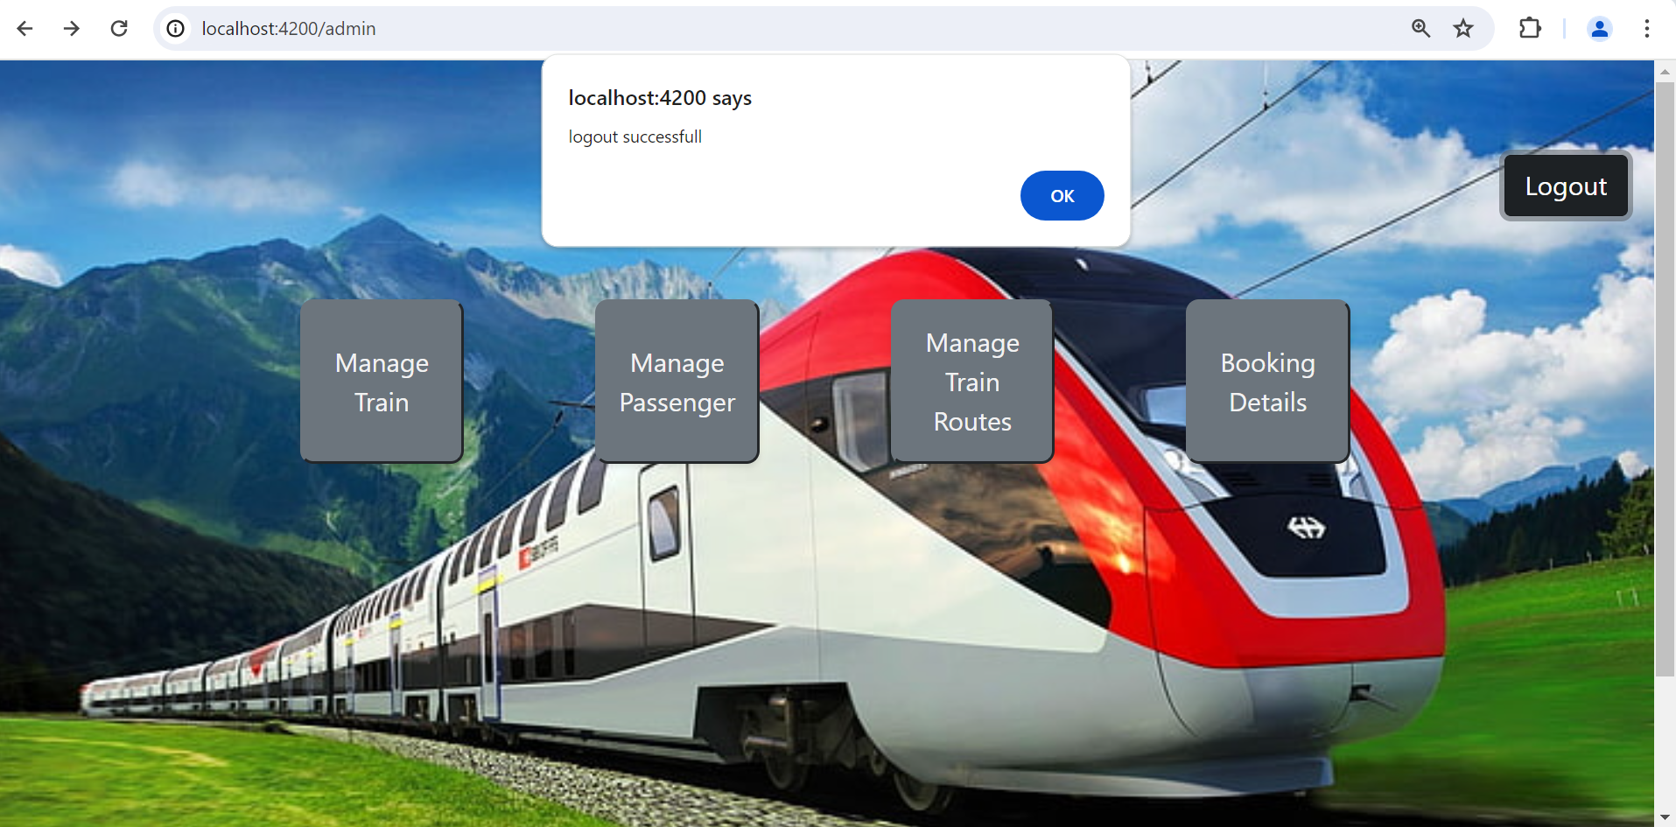
Admin Logout

Slide 12
PASSENGER HOME PAGE

Slide 13
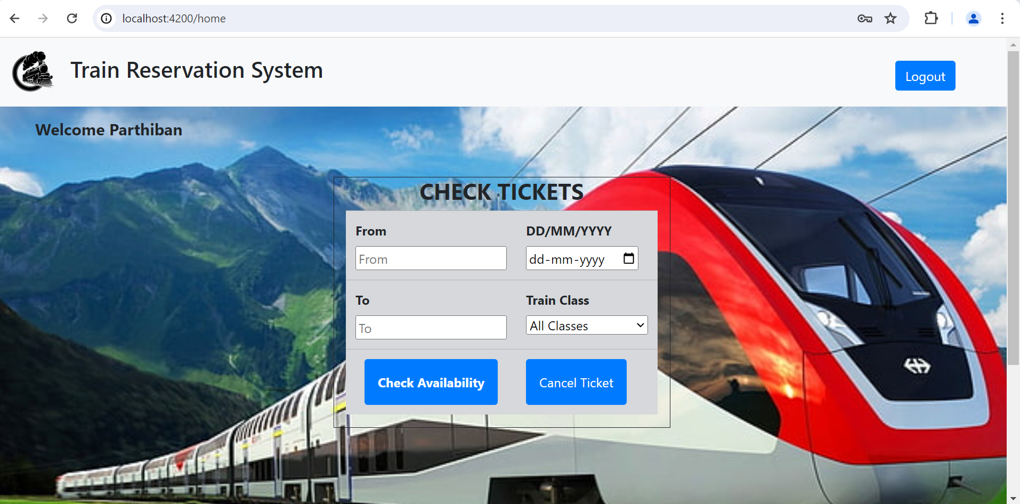
HOME PAGE

Slide 14
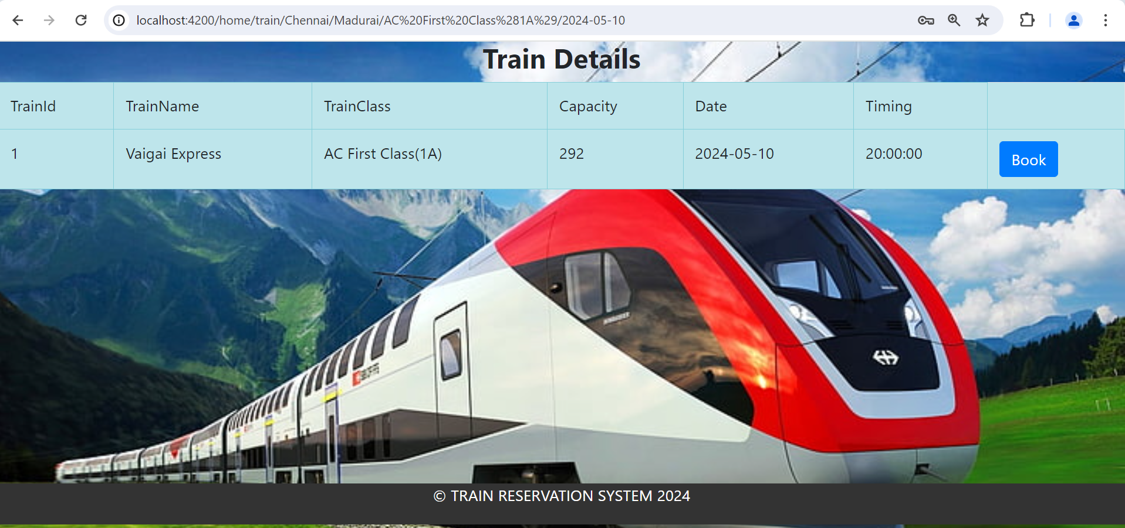
BASED ON FILTER IT WILL SHOW AVAILABLE TRAIN

Slide 15
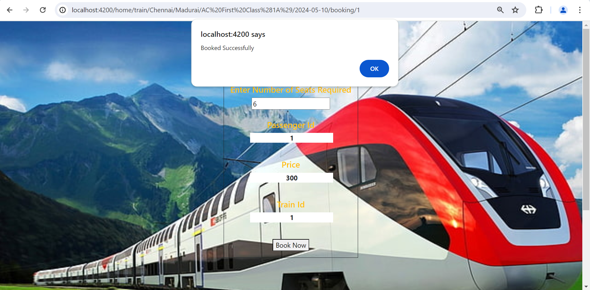
BOOKING PAGE

Slide 16
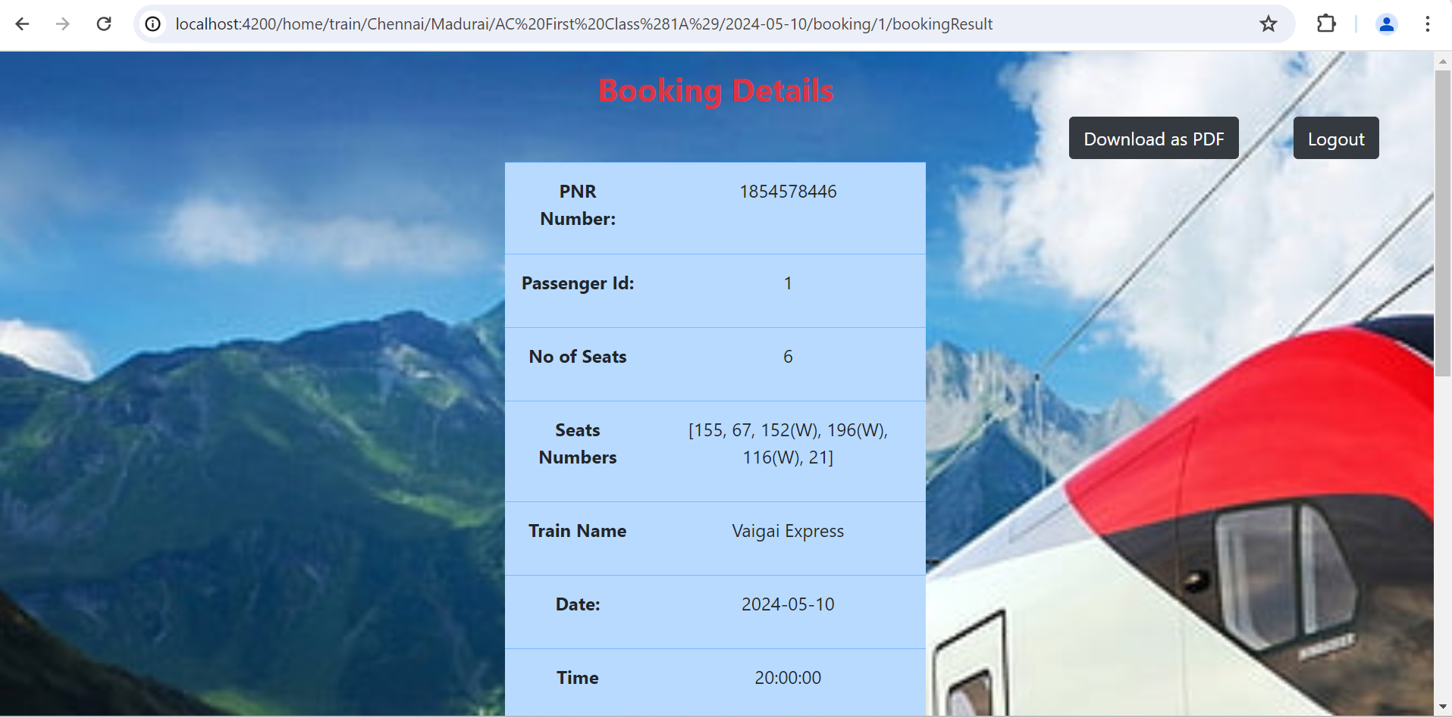
BOOKING DETAILS PAGE

Slide 17

THANK YOU

